Slide 1
D.ARISRADA
Real-time Car Detection using Haar Cascade Object Detection

Slide 2
Vehicle Detection and Tracking
Implements vehicle detection and tracking using OpenCV and Haar cascade classifiers.
Captures frames from a video source.
Detects vehicles within each frame.
Draws bounding boxes around detected vehicles.
Displays the number of detected vehicles in the "North" direction.
Provides a message indicating traffic conditions based on the count.
Serves as a basic implementation of vehicle detection and tracking.
Can be enhanced with advanced algorithms and optimizations for real-world applications like traffic management and surveillance.

Slide 3


AGENDA
Problem Statement
Project Overview
End Users
Solutions
Wow Content
Modelling
Results
3/21/2024 Annual Review

Slide 4

PROBLEM STATEMENT
Develop a system for vehicle detection and tracking using computer vision techniques.
Create a program capable of identifying vehicles within a video stream or set of images.
tracking mechanisms to monitor vehicle movements over time.
Provide insights such as traffic flow analysis based on detected vehicles.
Ensure the system can handle challenges like changes in lighting conditions, occlusions, and variations in vehicle sizes and shapes.
Aim for real-time performance and high accuracy to be applicable in scenarios like traffic management, surveillance, and autonomous vehicles.

Slide 5

PROJECT OVERVIEW
Develops a real-time vehicle detection and tracking system using computer vision techniques.
Utilizes OpenCV and Haar cascade classifiers to identify vehicles in video streams.
Enables traffic analysis and surveillance applications.
Features adaptive algorithms to handle varying conditions effectively.
Offers integration potential with existing infrastructure for seamless implementation.
Applications include traffic management, surveillance, and support for autonomous vehicles.

Slide 6
WHO ARE THE END USERS?
The end users of our vehicle detection and tracking system encompass various sectors and industries. Traffic management authorities can utilize the system to optimize signal timings and alleviate congestion. Law enforcement agencies can employ it for surveillance and monitoring purposes, enhancing public safety. Additionally, transportation companies can integrate the system into their fleet management solutions to improve efficiency and track vehicle movements.

Slide 7

YOUR SOLUTION AND ITS VALUE PROPOSITION
Our solution offers a robust vehicle detection and tracking system, leveraging advanced computer vision techniques for real-time analysis. By accurately identifying and tracking vehicles in video streams, our system provides valuable insights into traffic patterns, aiding in congestion management and traffic flow optimization. The integration potential with existing infrastructure enhances its value proposition, allowing seamless implementation for traffic authorities, law enforcement agencies, transportation companies, and urban planners.

Slide 8

THE WOW IN YOUR SOLUTION
The wow factor in our solution lies in its ability to deliver accurate and real-time vehicle detection and tracking, revolutionizing how traffic management and surveillance are conducted. By harnessing cutting-edge computer vision techniques, our system offers unparalleled precision, even in challenging environments with varying lighting and occlusions. Its seamless integration potential with existing infrastructure enhances its versatility and applicability across different sectors
3/21/2024 Annual Review

Slide 9
MODELLING
Utilizes a combination of machine learning and computer vision techniques for accurate vehicle detection and tracking.
Preprocesses input data by extracting relevant features and enhancing image quality.
Trains models using labeled datasets, employing algorithms like Haar cascade classifiers and deep learning architectures such as Convolutional Neural Networks (CNNs).
Models learn to recognize vehicle patterns and distinguish them from the background during training.
Fine-tunes the models to optimize performance and adapt to various environmental conditions.

Slide 10
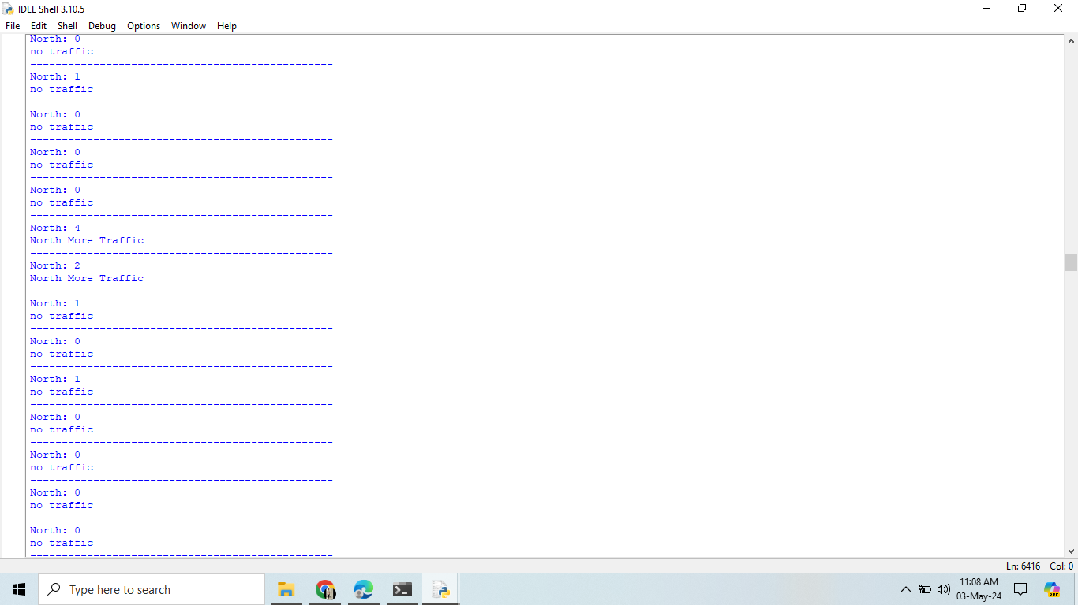
RESULTS
The results of our vehicle detection and tracking system demonstrate its effectiveness and reliability in real-world scenarios. Through extensive testing and evaluation, we have achieved high accuracy rates in identifying and tracking vehicles within video streams.

